Slide 1
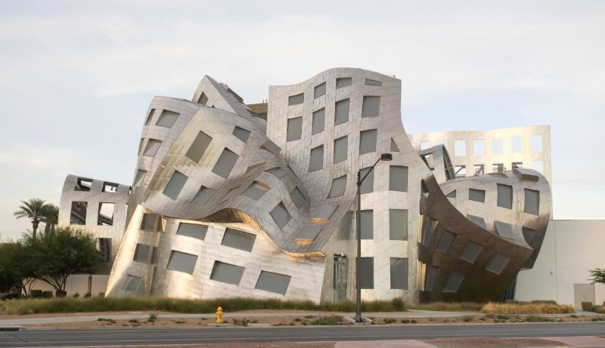

The Paper Tablet Project
Image Processing and Vision
Prof. João Paulo Costeira & Prof. Carlos Santiago
Group 9
André Silva nº 90015 | Luís Coelho nº 90127 | Maria Louro da Silva nº 92828 | Marta Loureiro nº 92834

Slide 2
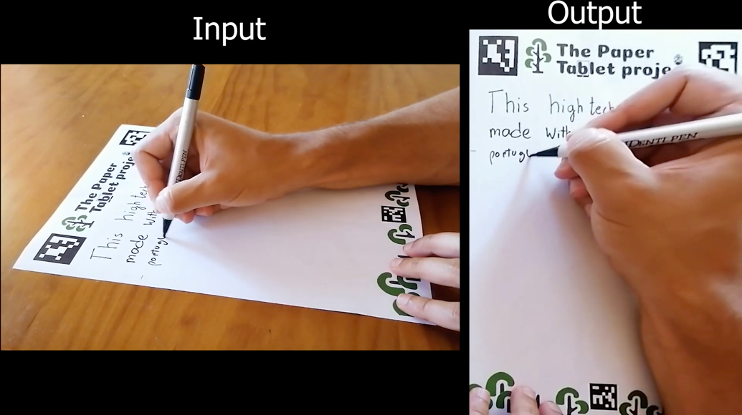
The Pitch| A Brief Summary

Slide 3
Approach | Task 1
Goals of Task 1
Approach for Task 1
Detect aruco markers coordinates to serve as good features for homography.
Transform the current frame unto the template image plane using aruco markers.
Compute homography matrix to transform the desired frame.
Geometry precision should be assured.
Identify hand pixels in frame to produce a mask and remove the hand from the image.
Although not a priority, hand removal or beautification can be performed.

Slide 4
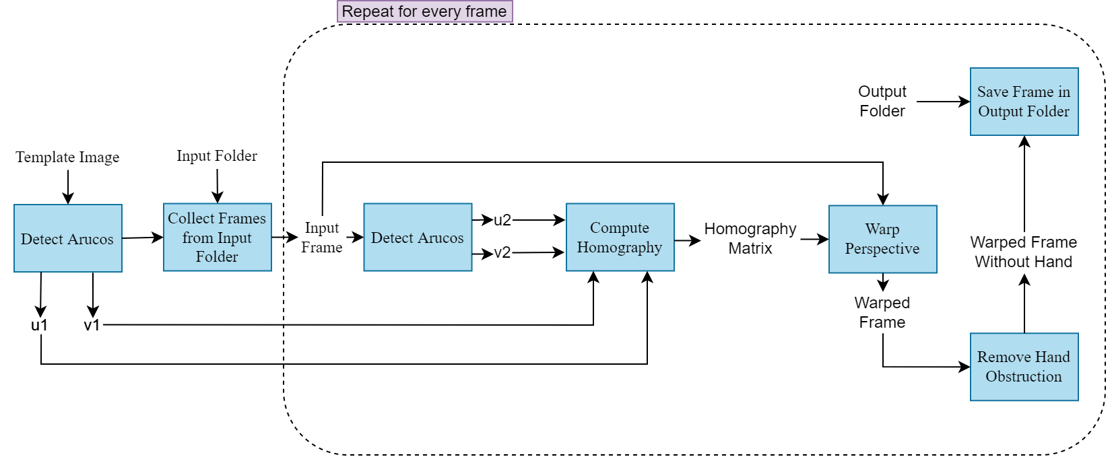
Approach | Task 1

Slide 5
Approach | Task 2
Goals of Task 2
Approach for Task 2
Transform the current frame unto the template image plane without using aruco markers.
Find inliers to serve as good features for homography.
Compute homography matrix to transform the desired frame.
Geometry precision should still be assured.
How to find inliers?
1
2
3
Detect Features
Find Matches
Assess Matches
SIFT
Flann Based Matcher
RANSAC

Slide 6
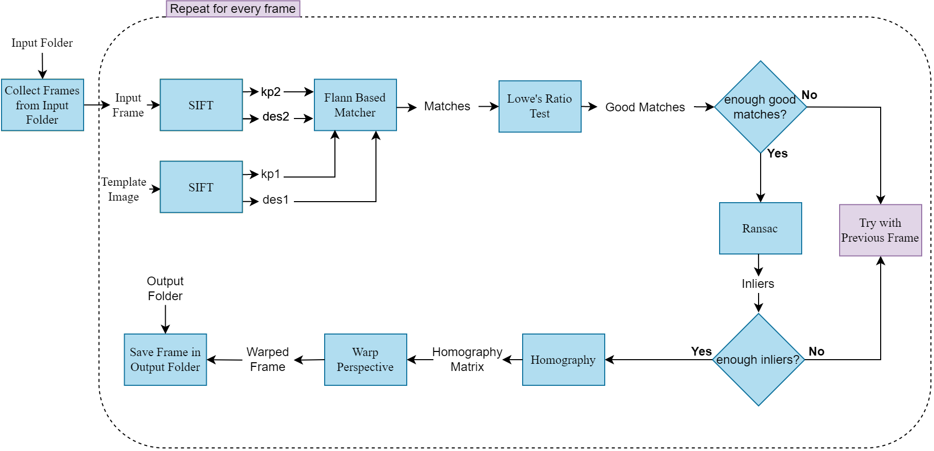
Approach | Task 2

Slide 7
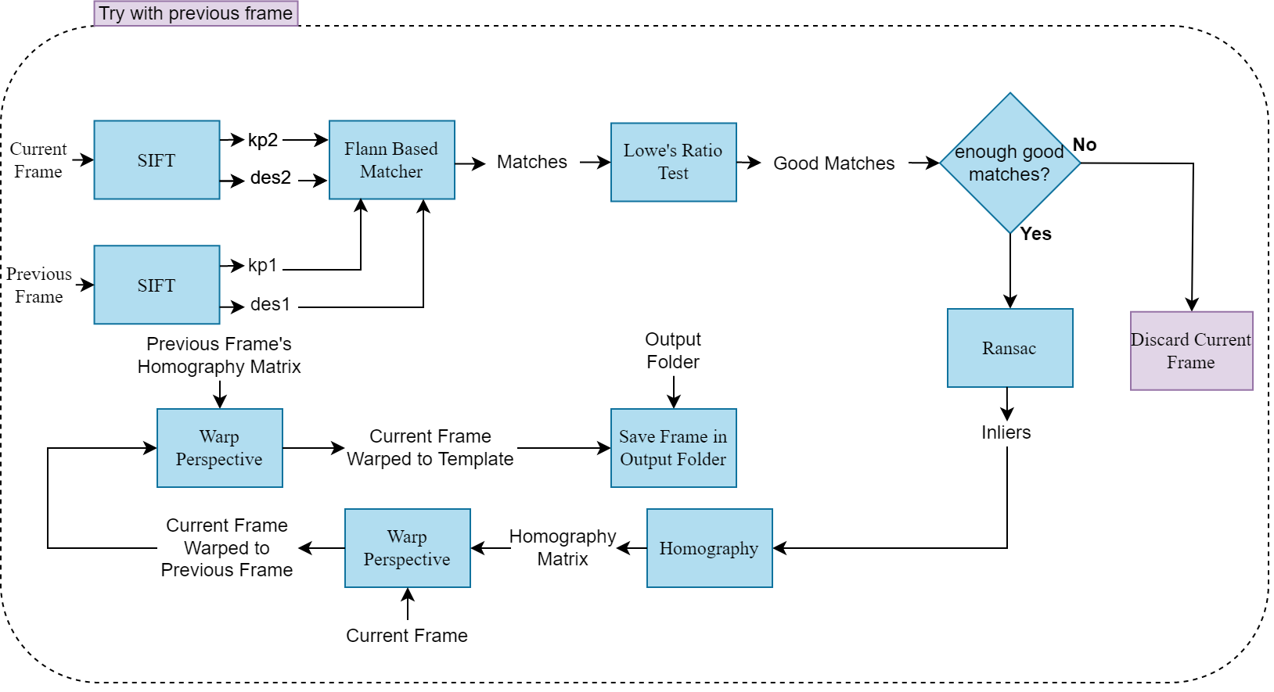
Approach | Task 2

Slide 8
Approach | Task 4
Goals of Task 4
Approach of Task 4
Transform two different perspectives unto the template plane without aruco markers and blend them together.
Use Task 2 processing pipeline to transform both perspectives onto the desired plane.
Blend together the resulting frames and color correct the result in post-processing.
Geometry precision should be assured.
Other methods such as background subtraction or hand detectors can be used to produce a great output.
Use a Median Filter as a means of background subtraction

Slide 9
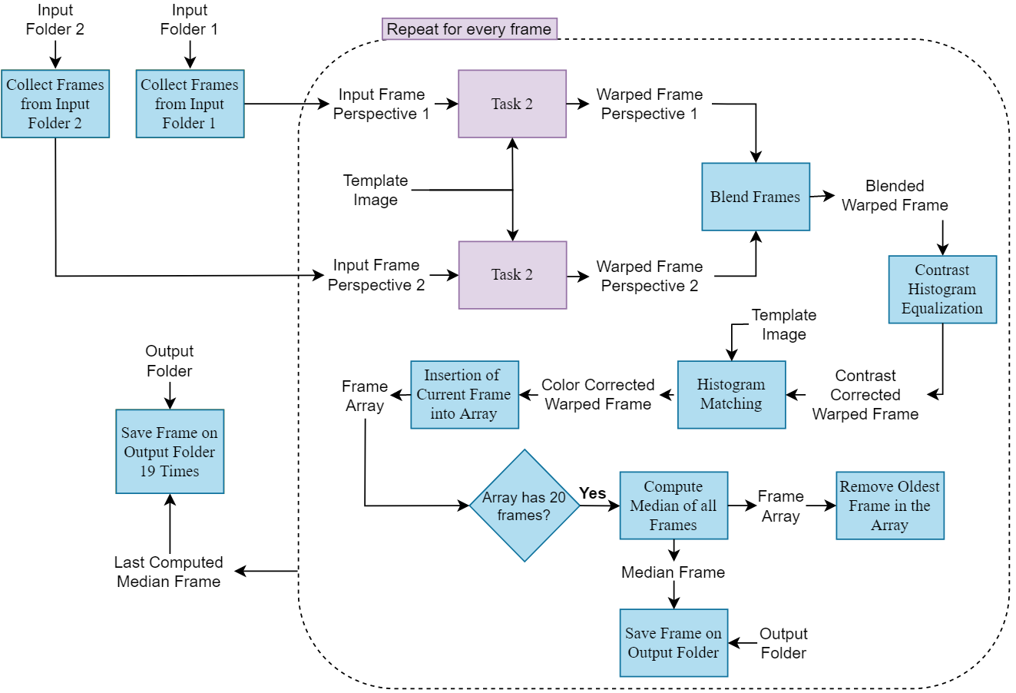
Approach | Task 4

Slide 10
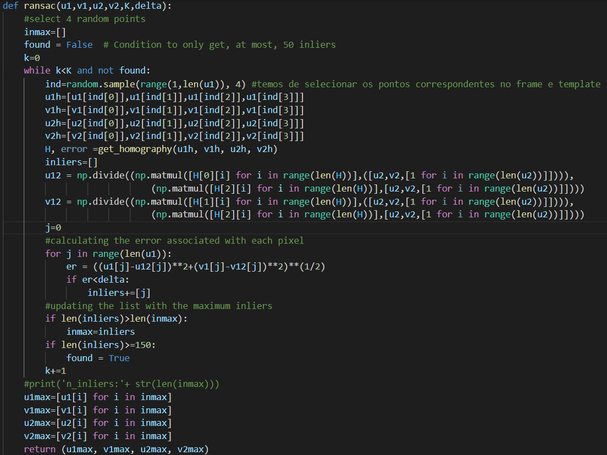
Implementation
OpenCV
Numpy
Scikit-image
Random
Glob
Sys

Slide 11
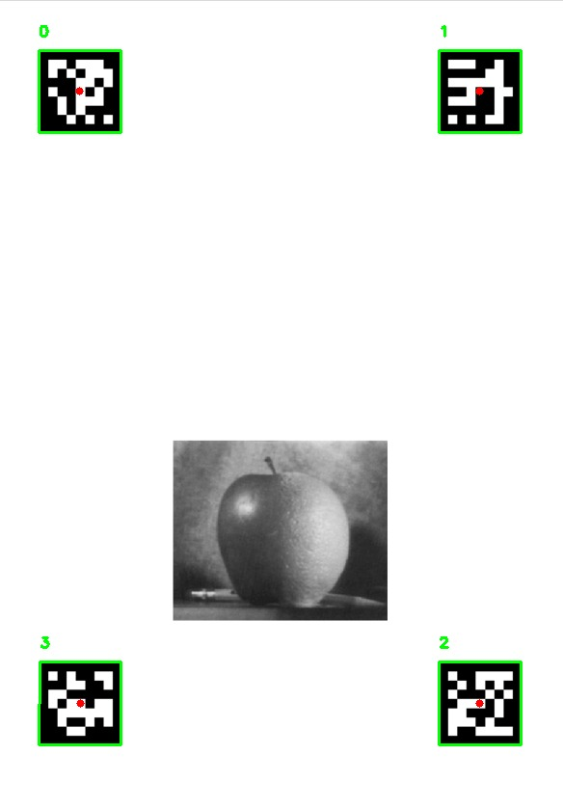
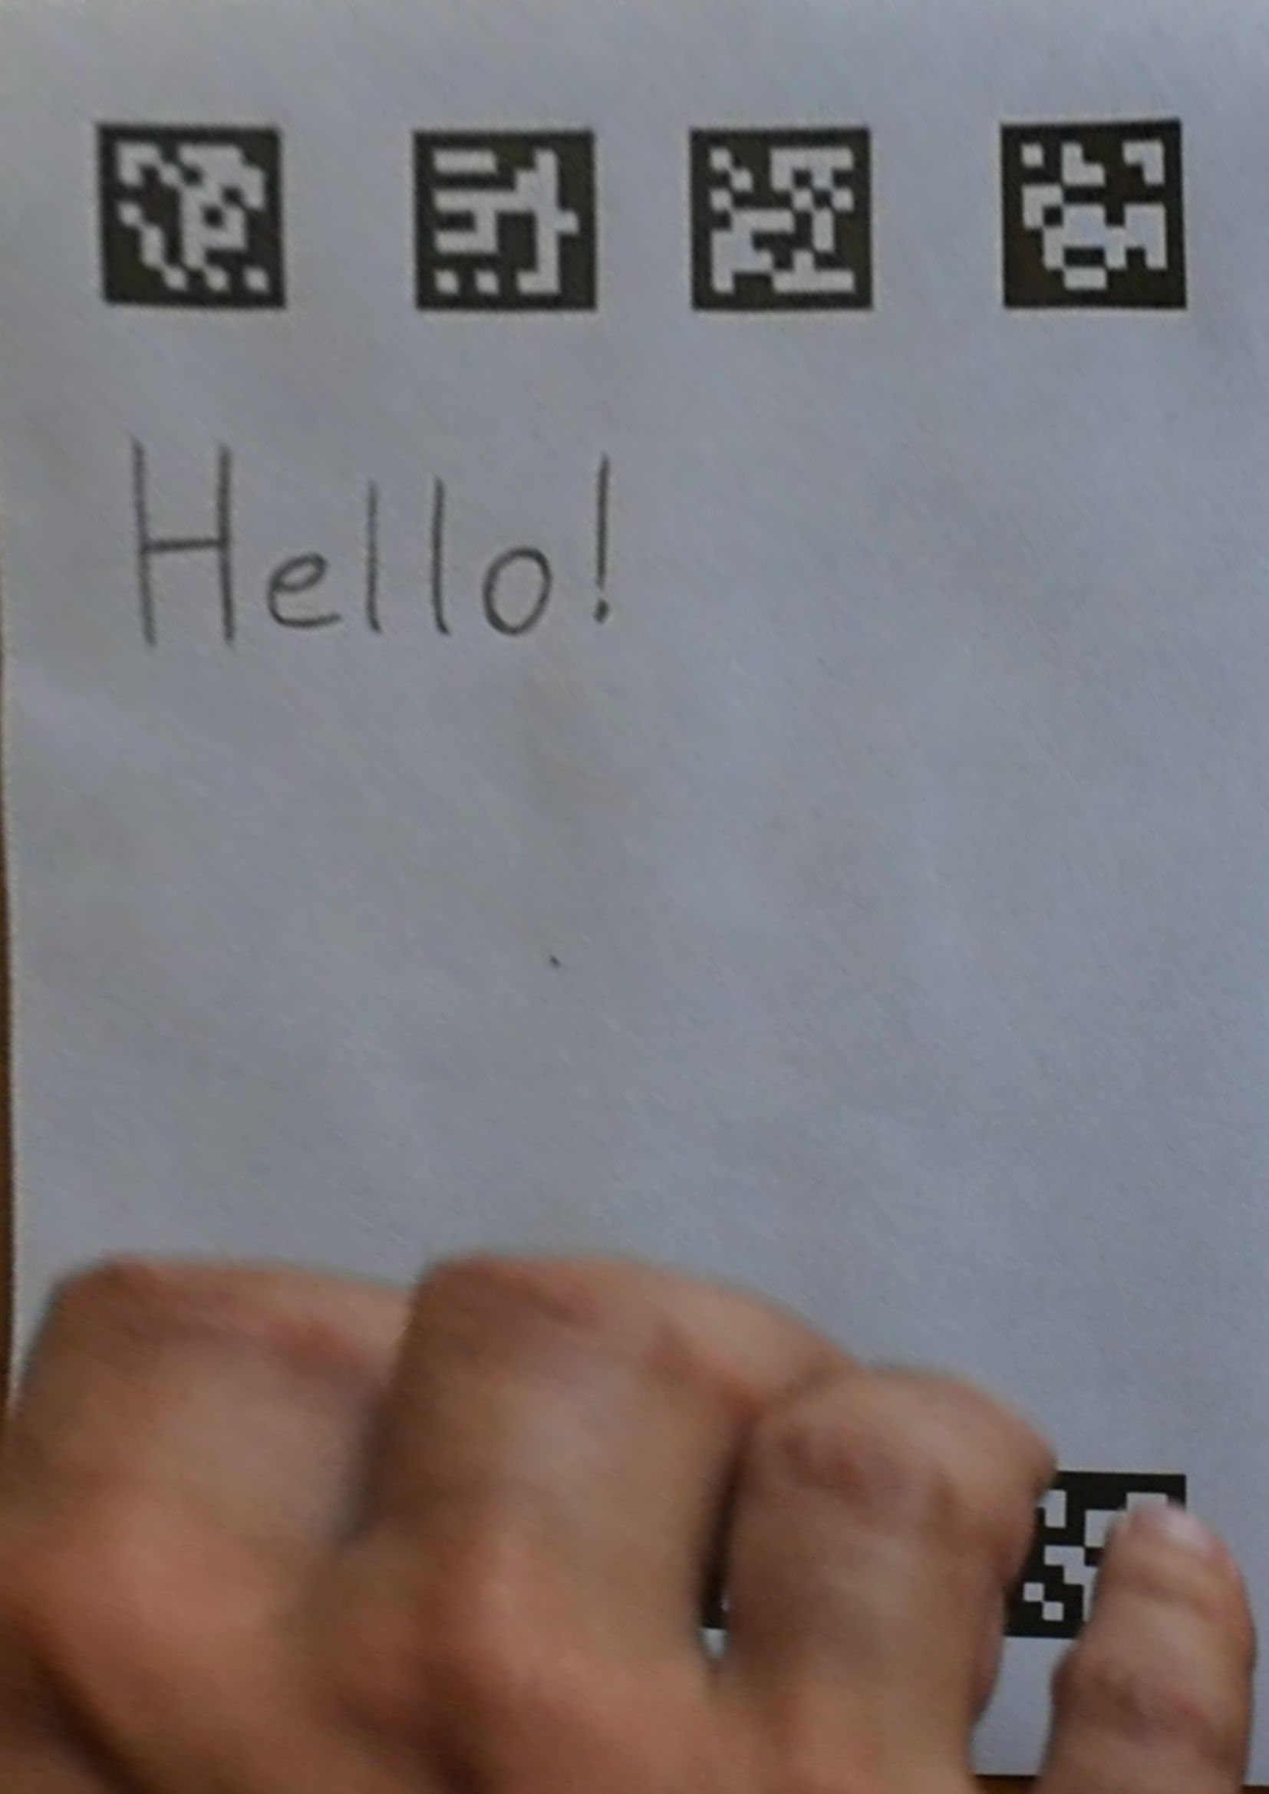
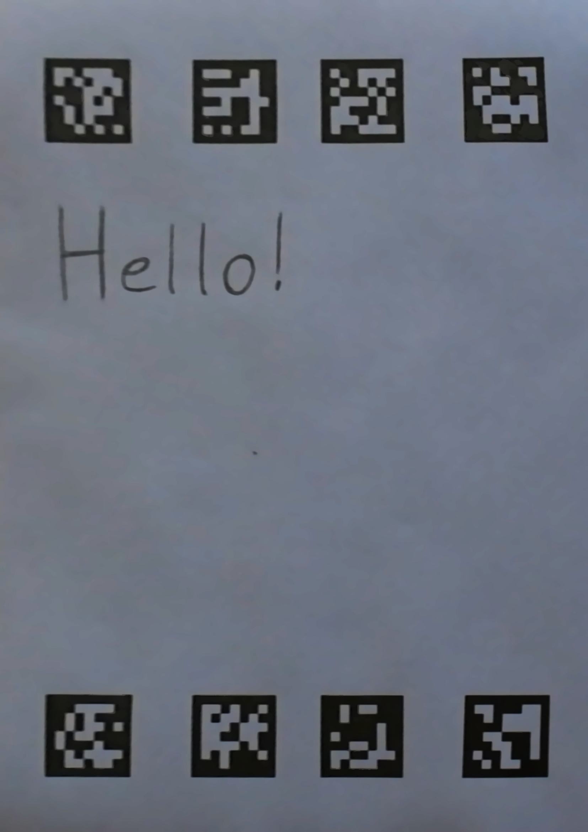
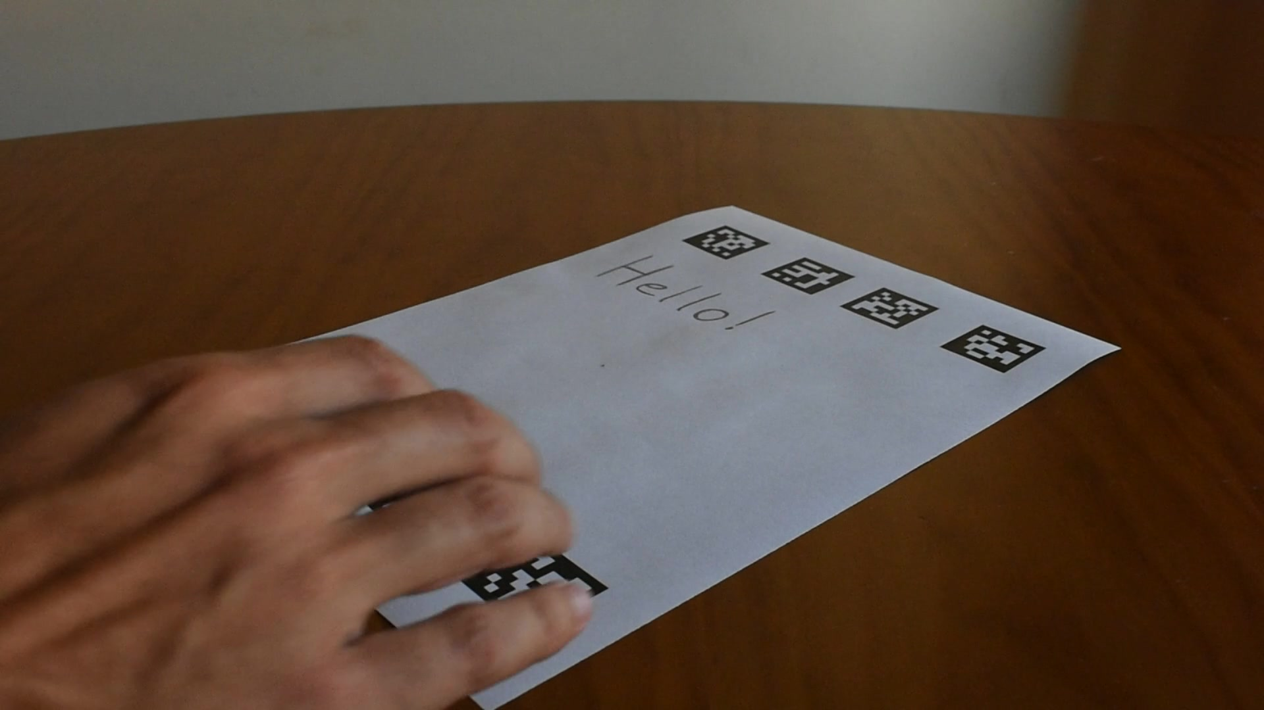
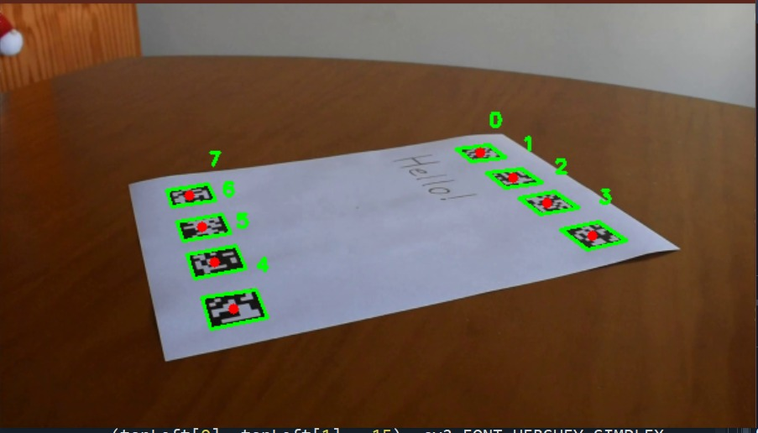
Results | Task 1
Aruco Identification
DICT_7X7_50
Input Image
First Output
Output without hand

Slide 12
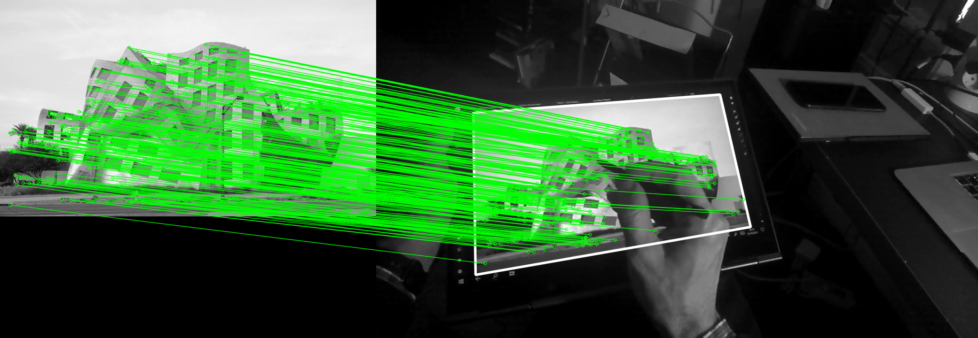
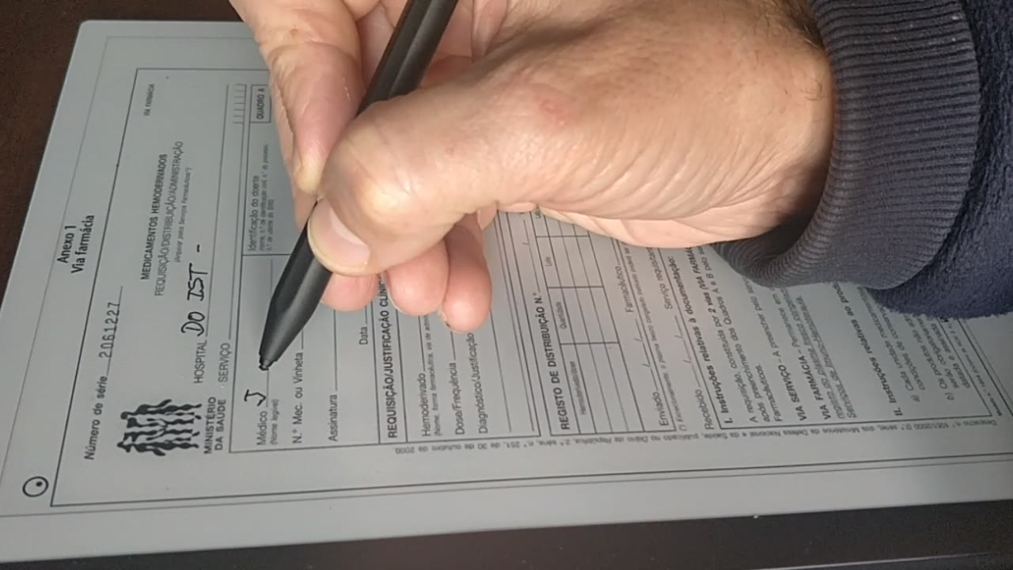
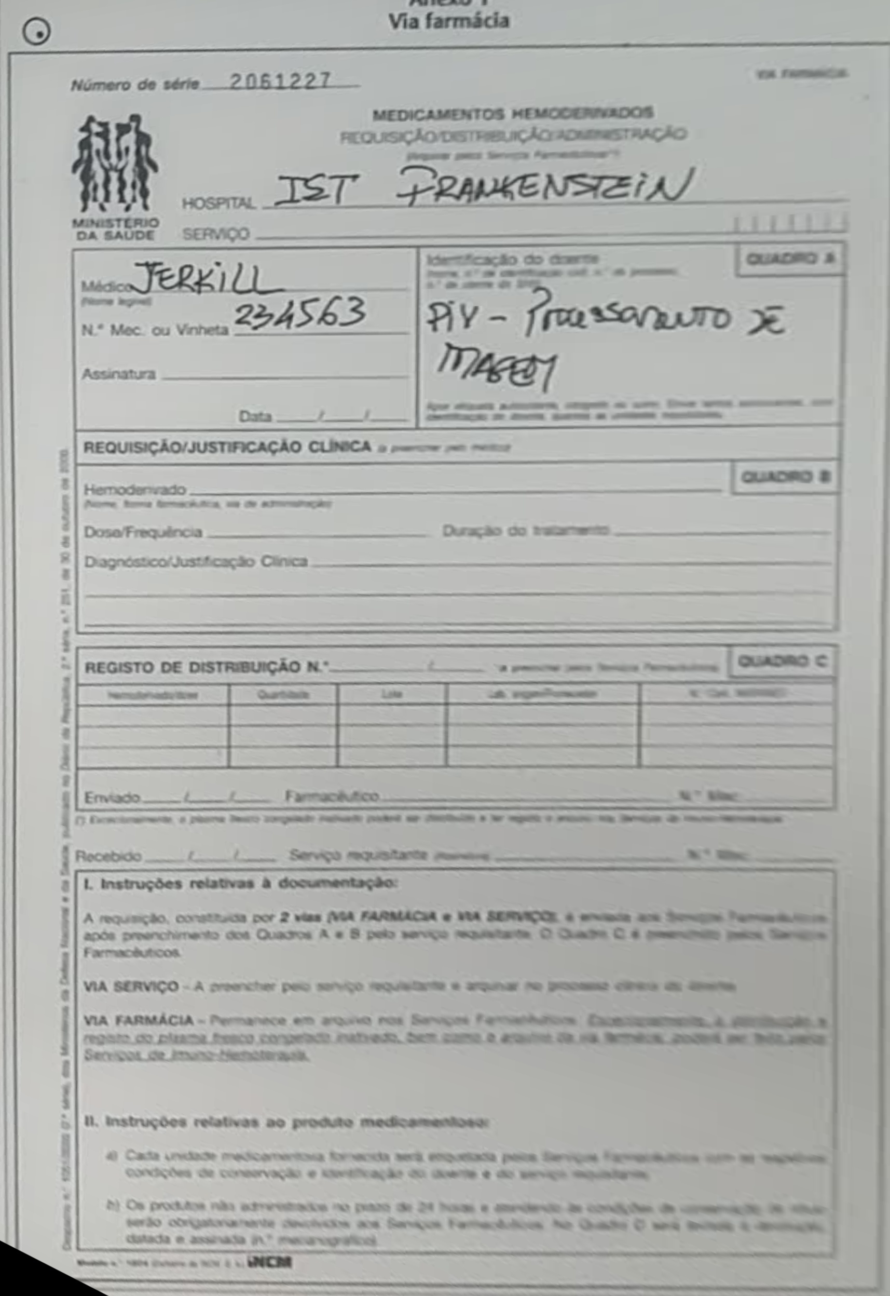
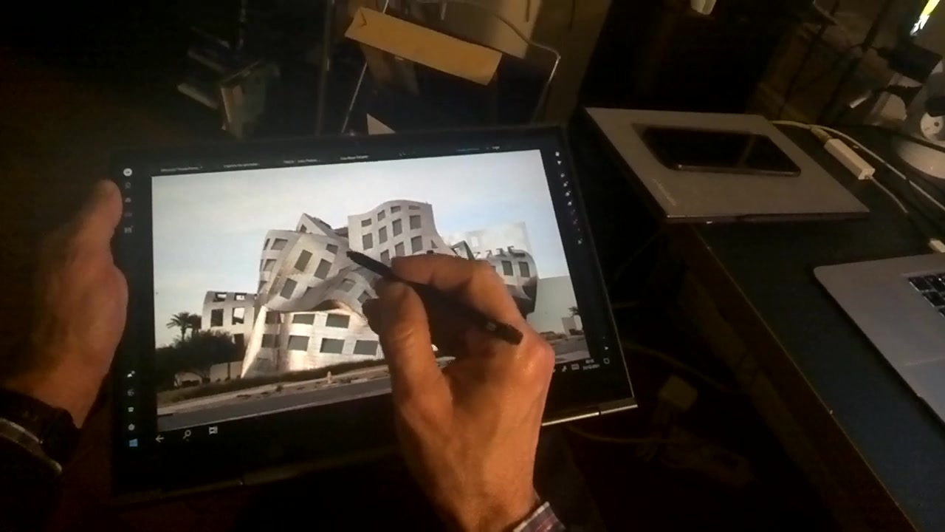
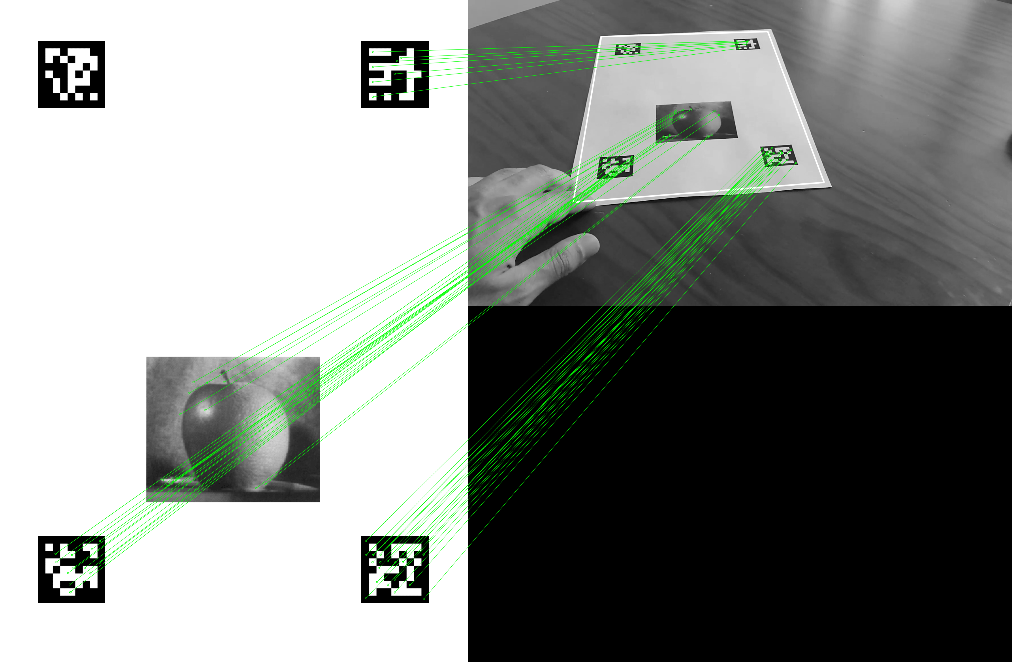
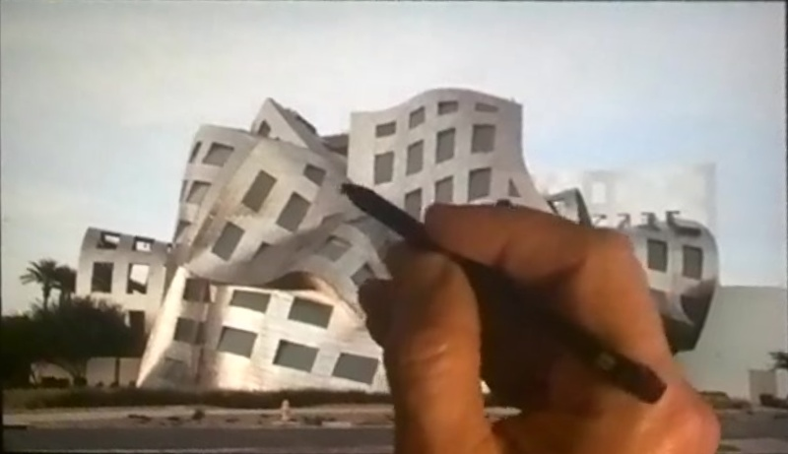
Results | Task 2
Key Points Identification

Slide 13
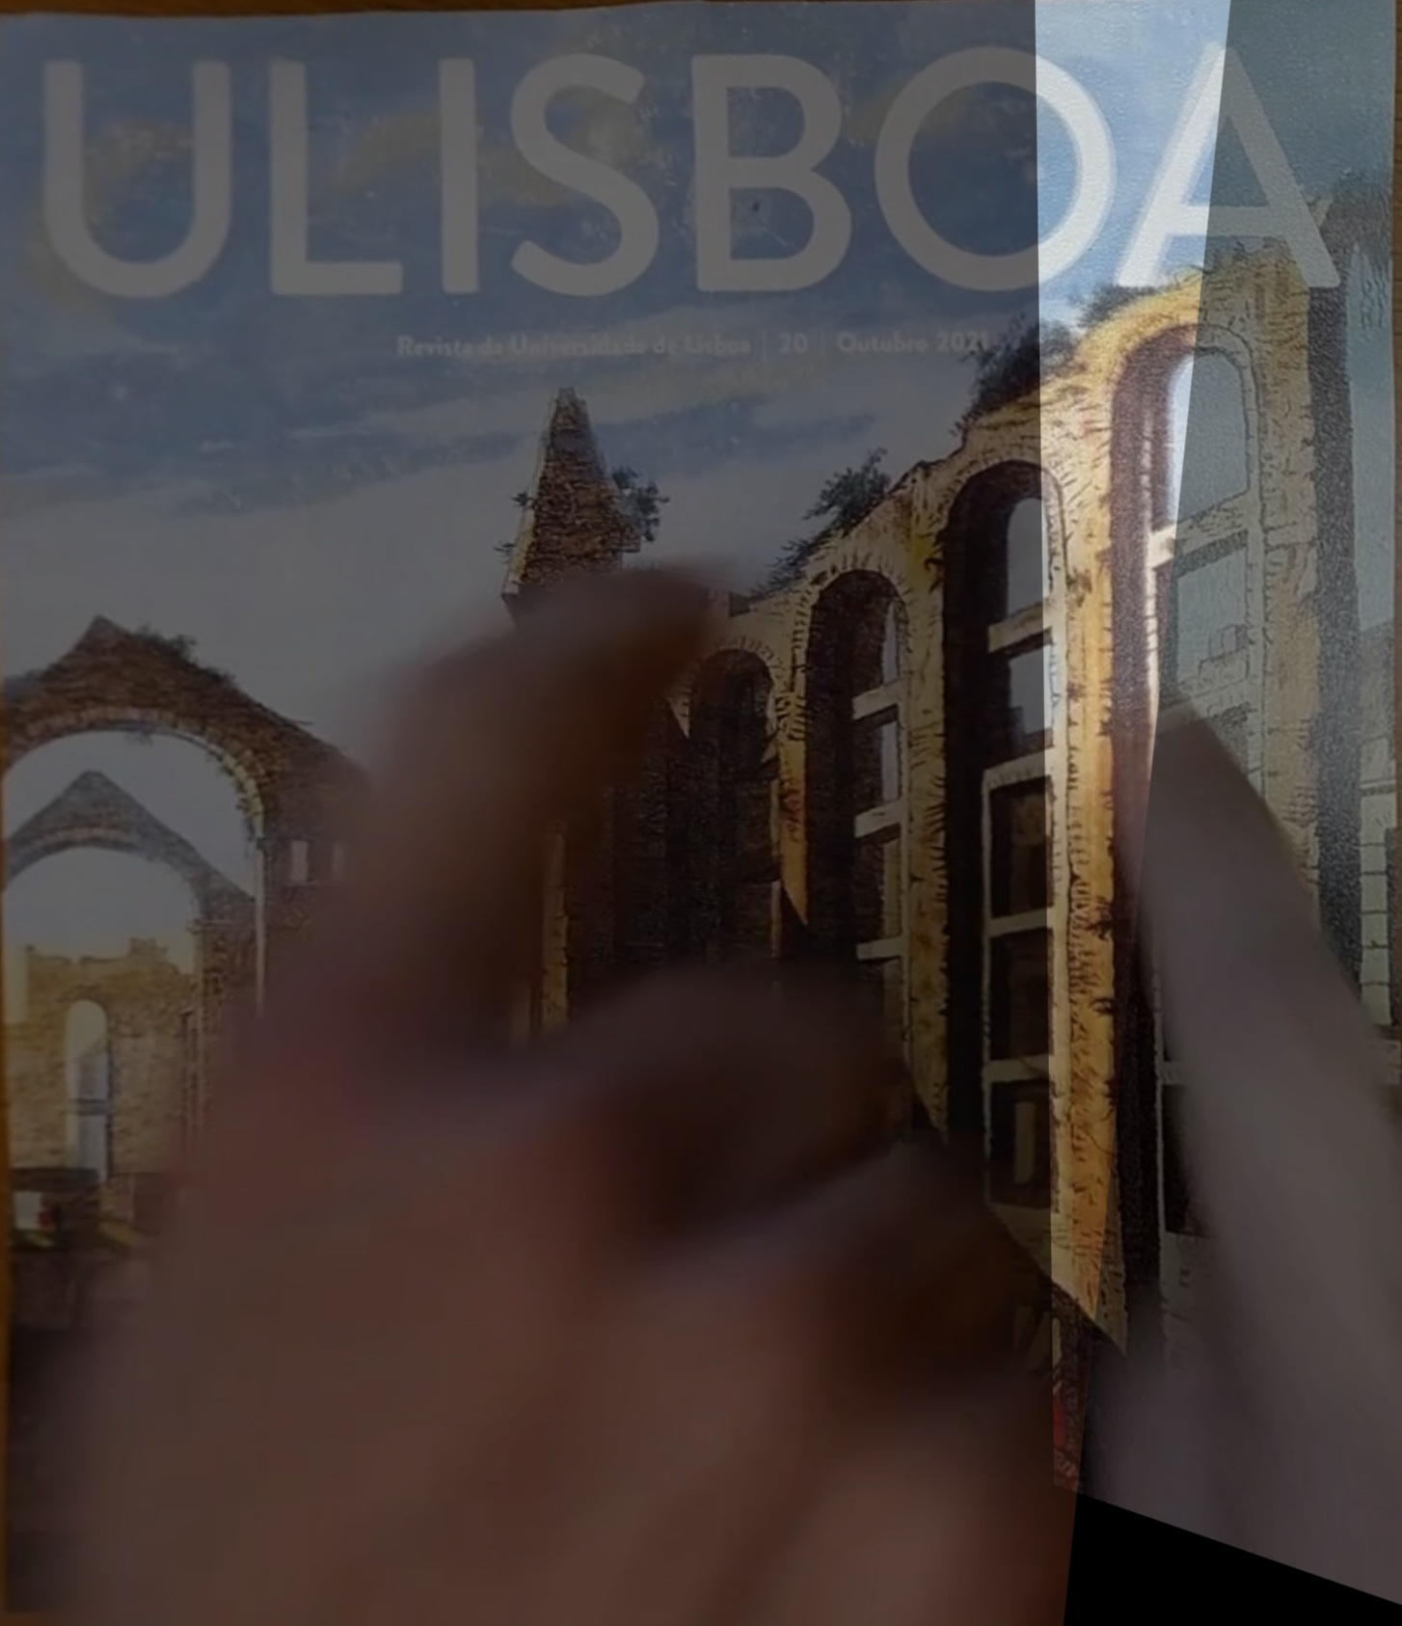
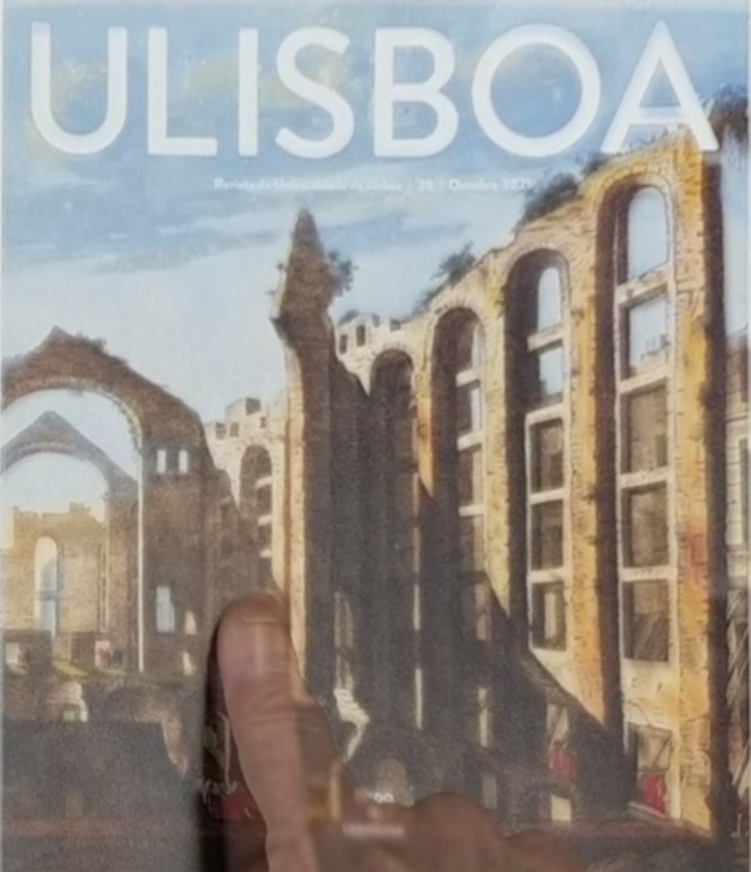
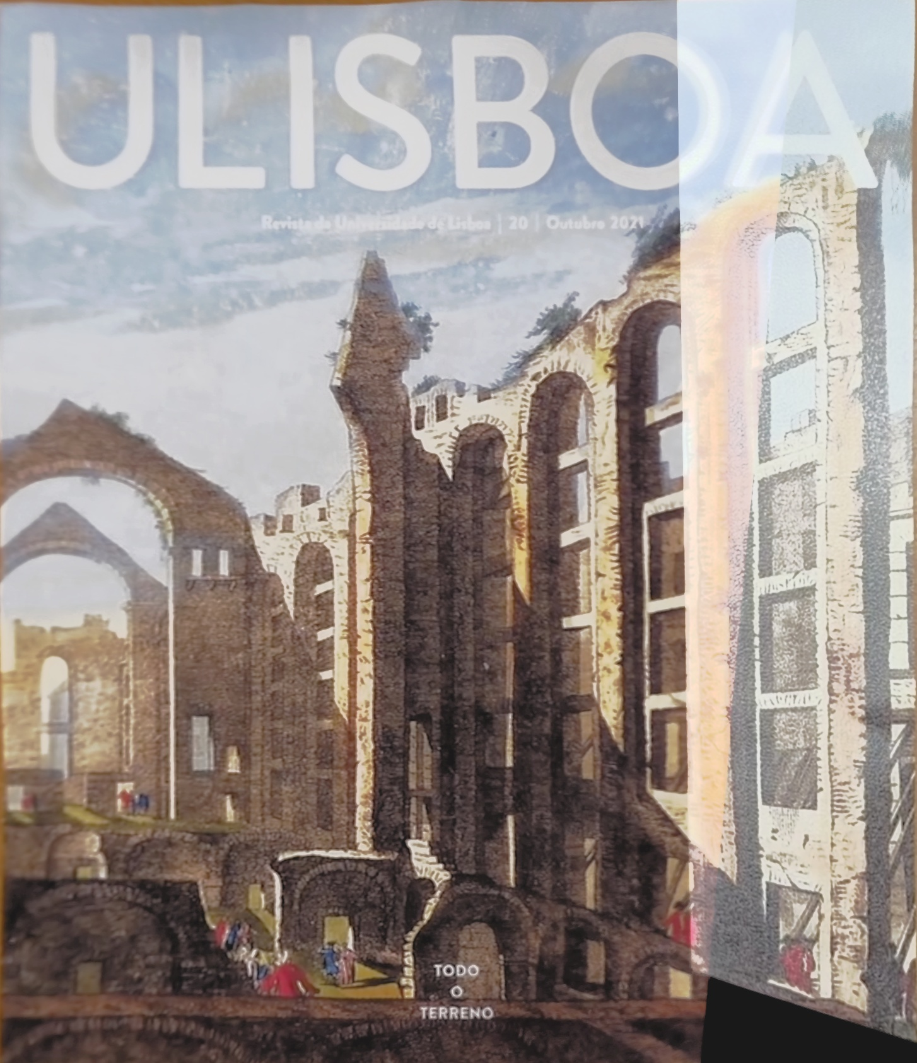
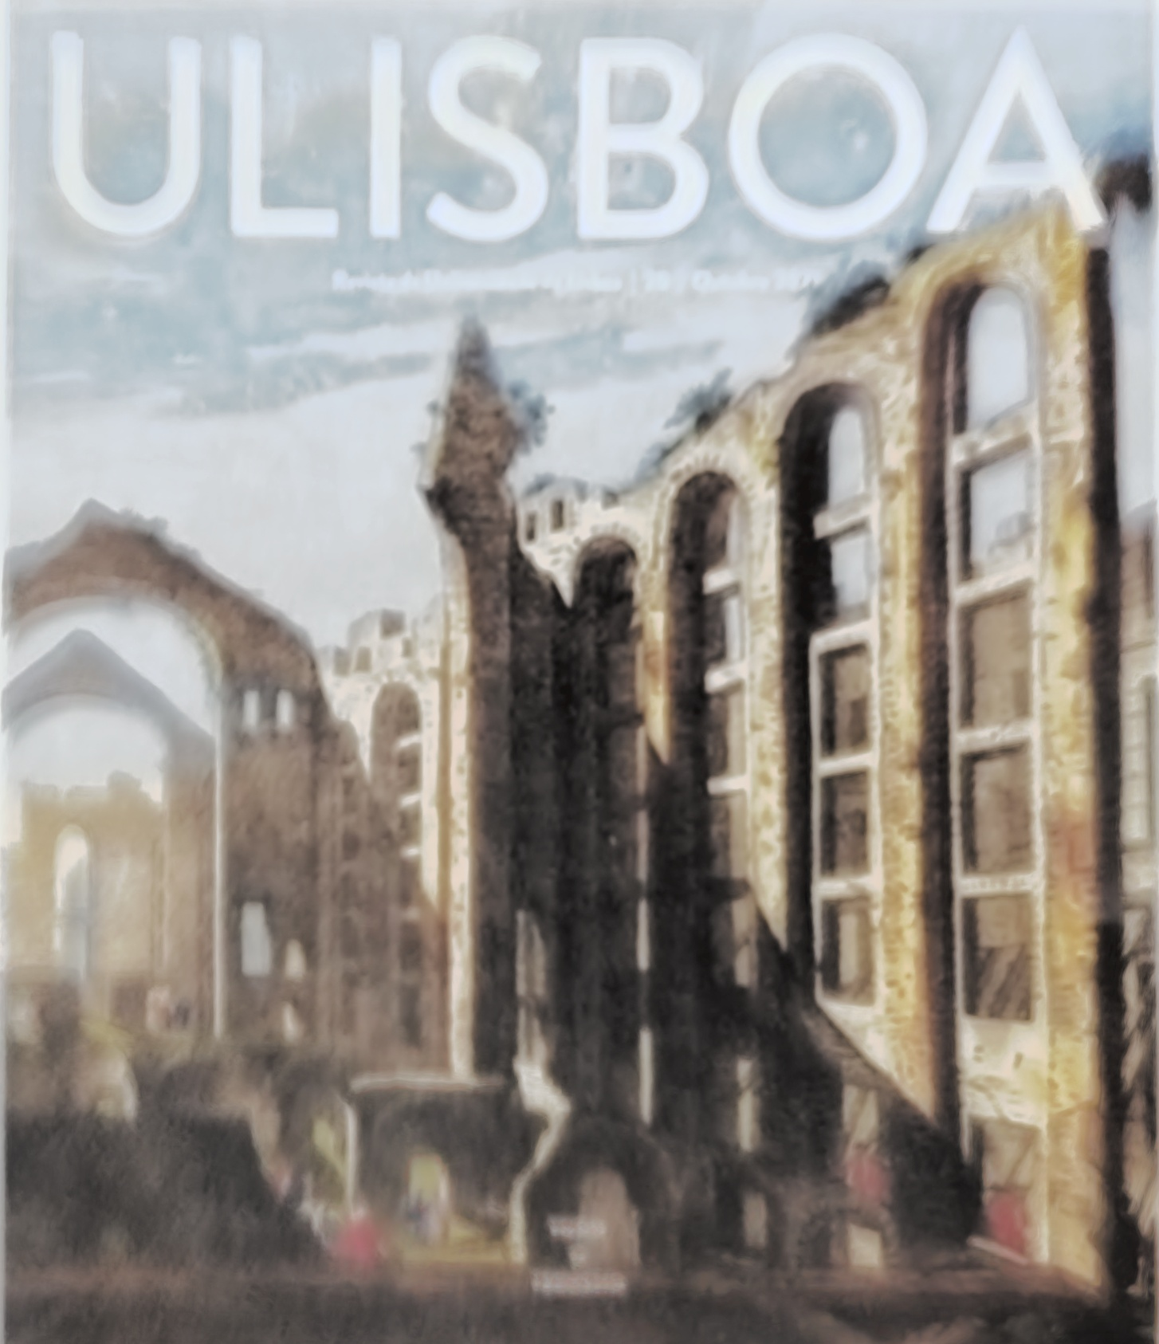
Results | Task 4
Major Problem
Final Output
Decrease brightness using blending on Ulisboa 2

Slide 14
Discussion | Task 2
During Task 2, we faced 4 major problems:
SIFT algorithm couldn’t find enough matches in some frames.
The computational Time
Some distortion in FewArucos.
Problems in Google Glass.

Slide 15
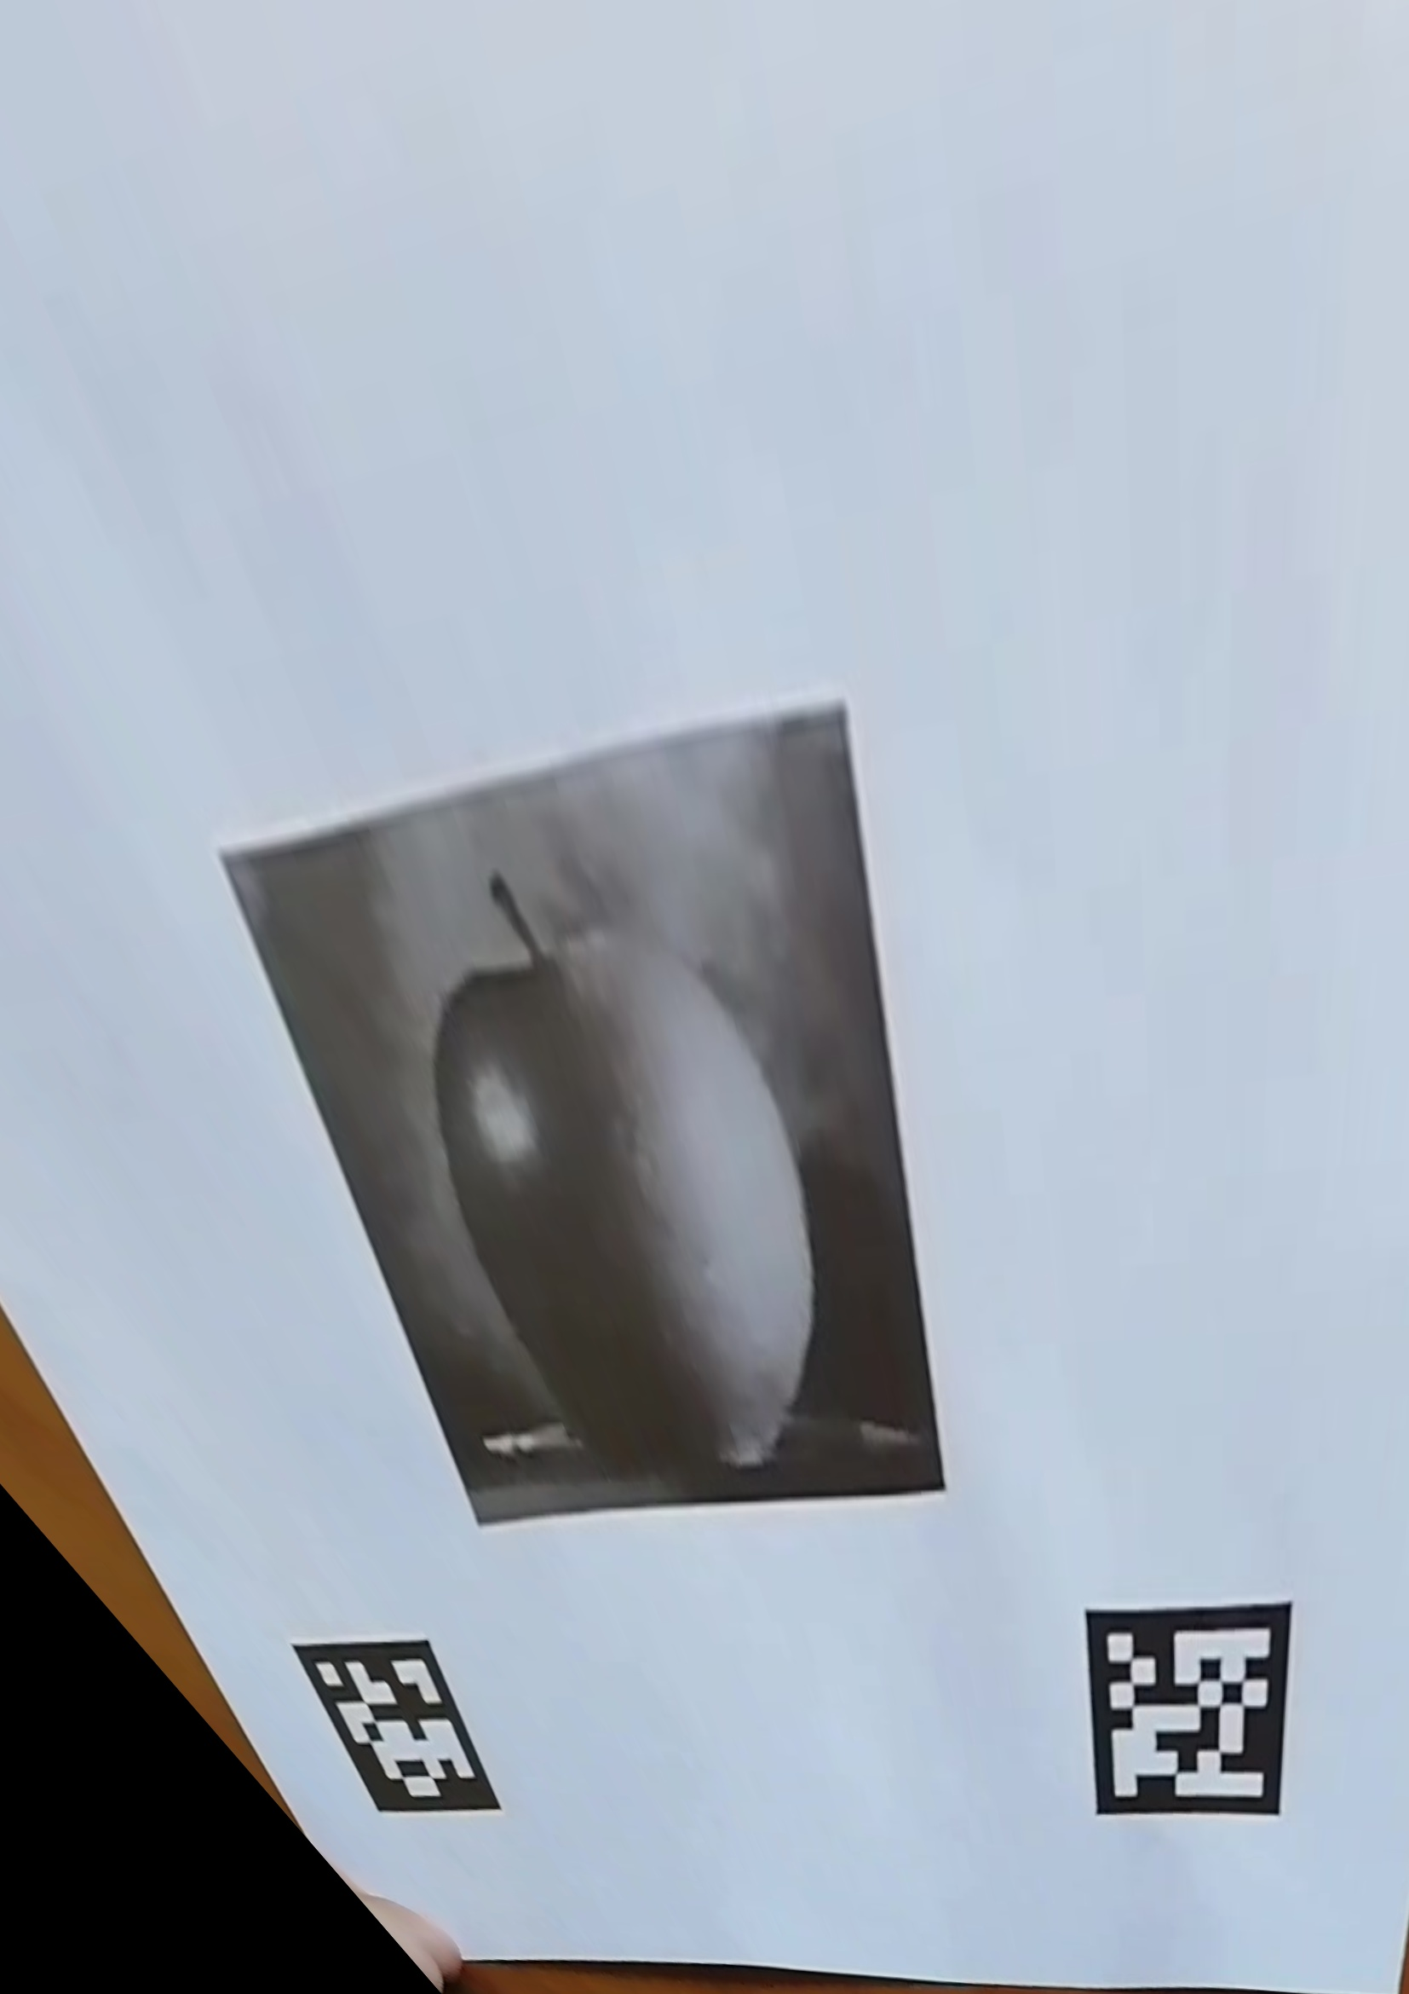
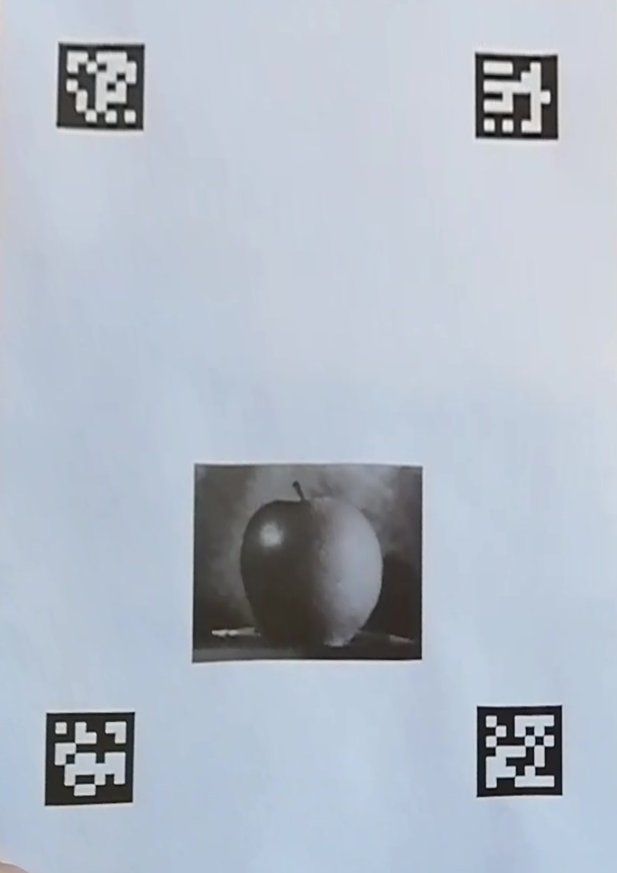
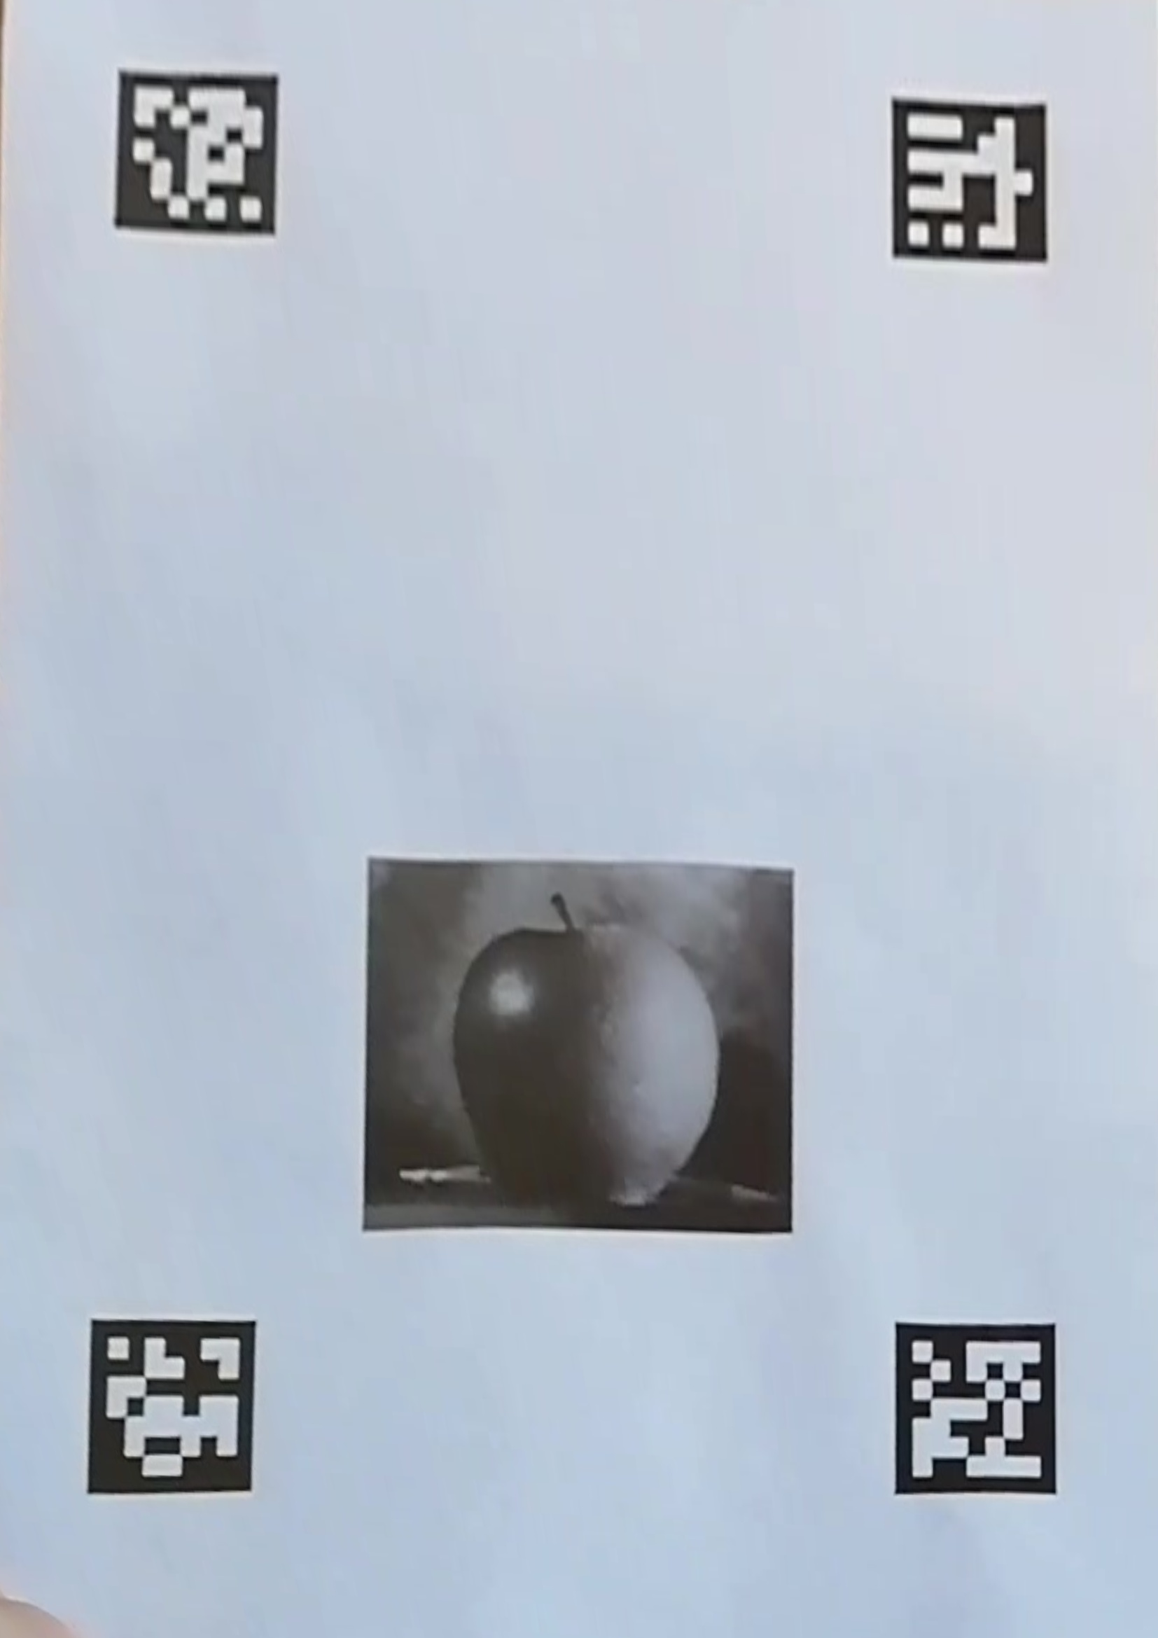
Discussion | Task 2
During Task 2, we faced 4 major problems:
We solved this problem by performing the homography with the previous frame
SIFT algorithm couldn’t find enough matches in some frames.
The computational Time
Some distortion in FewArucos.
Problems in Google Glass.
Minimum good matches=15
Minimum inliers=9
Minimum good matches=10
Minimum inliers=15
Minimum good matches=15
Minimum inliers=15

Slide 16

Discussion | Task 2
Solution:
If the number of inliers ≥ 150, then RANSAC selects this model.
During Task 2, we faced 4 major problems:
SIFT algorithm couldn’t find enough matches in some frames.
We solved this problem by adding a condition in RANSAC, that limited the search for the best model.
The computational Time
Some distortion in FewArucos.
Problems in Google Glass.

Slide 17
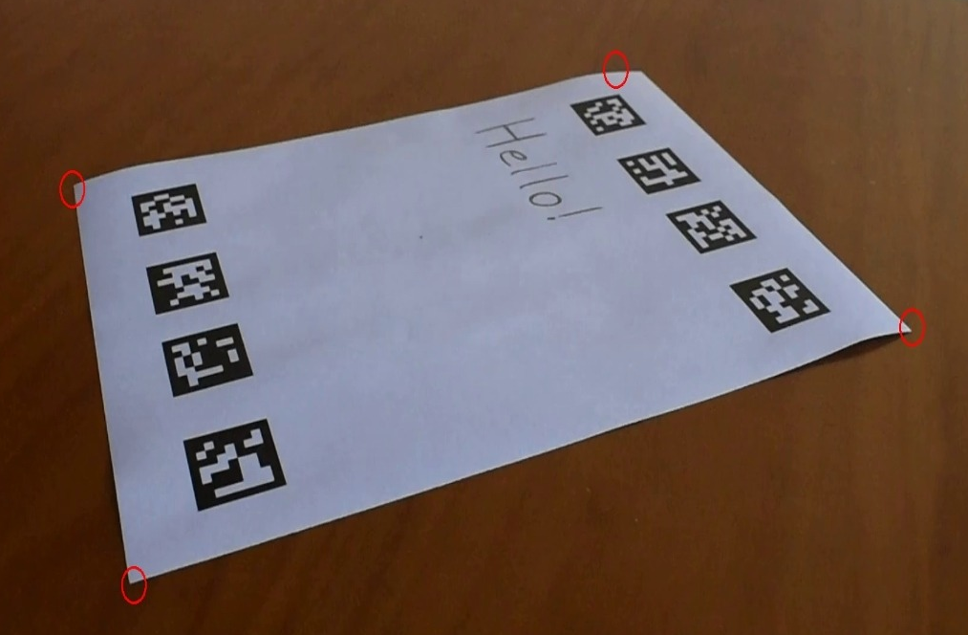

Discussion | Task 2
Corner misidentified!
During Task 2, we faced 4 major problems:
SIFT algorithm couldn’t find enough matches in some frames.
The computational Time
We tried to solve it, by finding the corners of the paper
Some distortion in FewArucos.
Problems in Google Glass.

Slide 18
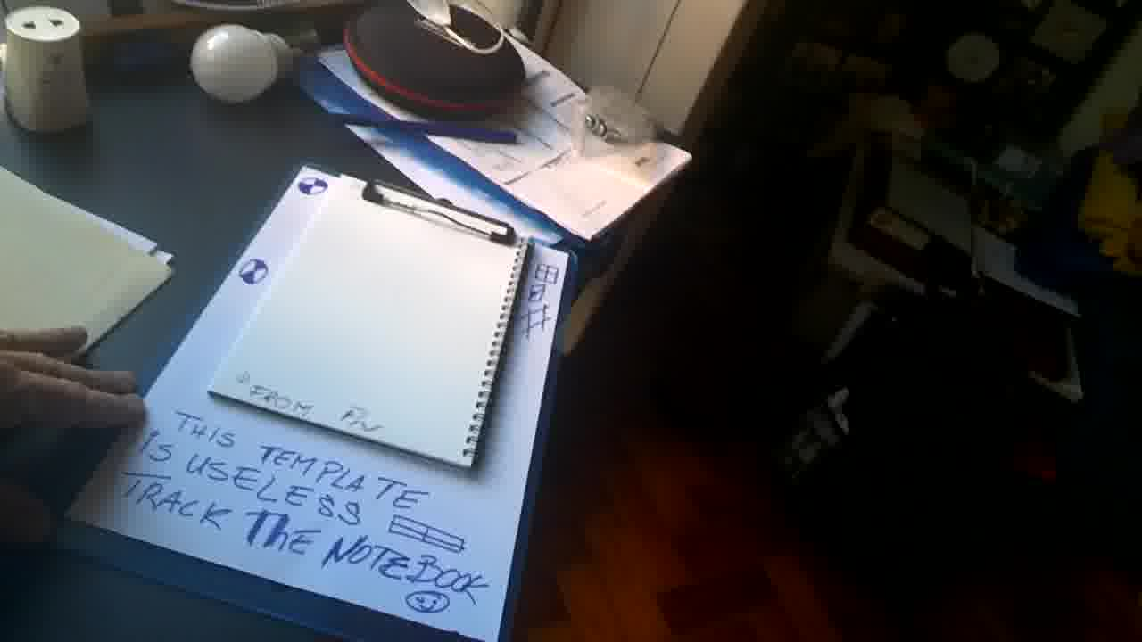
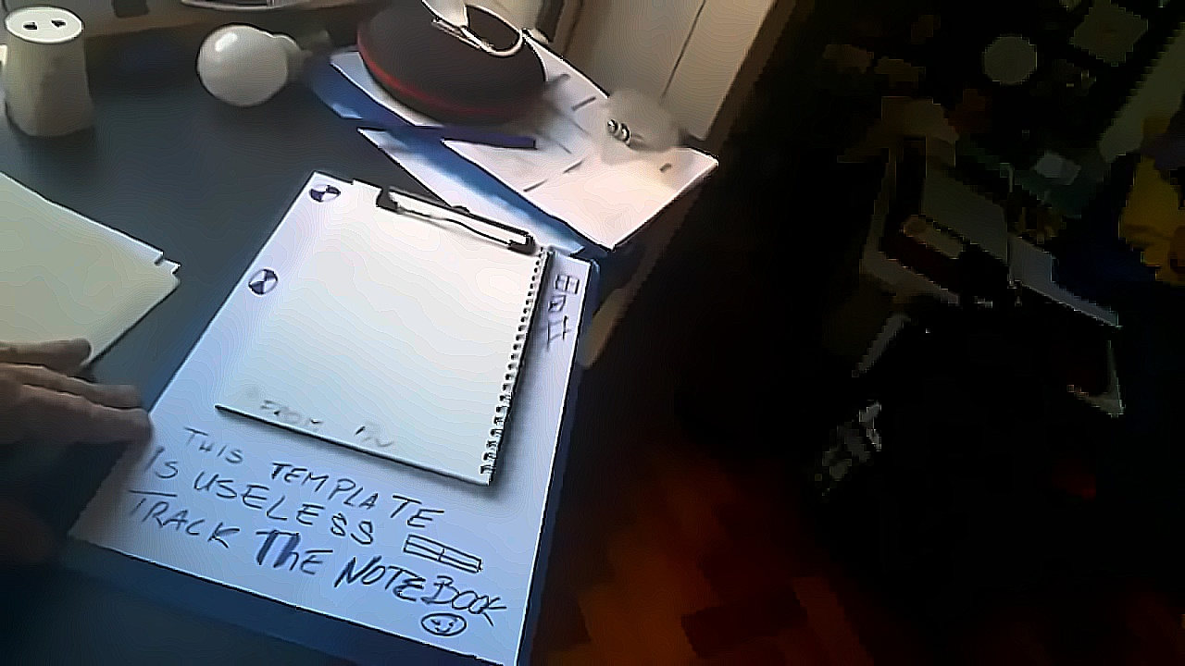
Discussion | Task 2
During Task 2, we faced 4 major problems:
SIFT algorithm couldn’t find enough matches in some frames.
The computational Time
Some distortion in FewArucos.
We tried to solve it, by using denoise and a sharpening filter
Problems in Google Glass.

Slide 19
Discussion | Task 4
Ulisboa 1
Ulisboa 2
Ulisboa 2
Good results with just blend. Need to remove objects and the hand
Bad results with just blend. Need to correct brightness and remove objects and the hand.
Bad results with just blend. Need to correct brightness and remove objects and the hand.
Several tries:
Median filter to the h, s and v in a hsv image;
Threshold values for h, s and v;
Delete the common parts.

Slide 20
Discussion | Task 4
Solution:
Histogram equalizer;
Median filter over time for 20 frames.
Ulisboa 1
Ulisboa 2

Slide 21
Discussion | Task 4
Ulisboa 1
Ulisboa 2
Solution:
Histogram equalizer;
Median filter over time for 20 frames.
Good results with just blend. Need to remove objects and the hand
Bad results with just blend. Need to correct brightness and remove objects and the hand.

